Slide 1

GYM-MASTER
TEAM :
VYOMA MANKAD
ANSH SEMWAL
GAURAV TATPATE
MENTORS :
ADITYA VIVEKANAND
ATHARV DUBEYYY

Slide 2

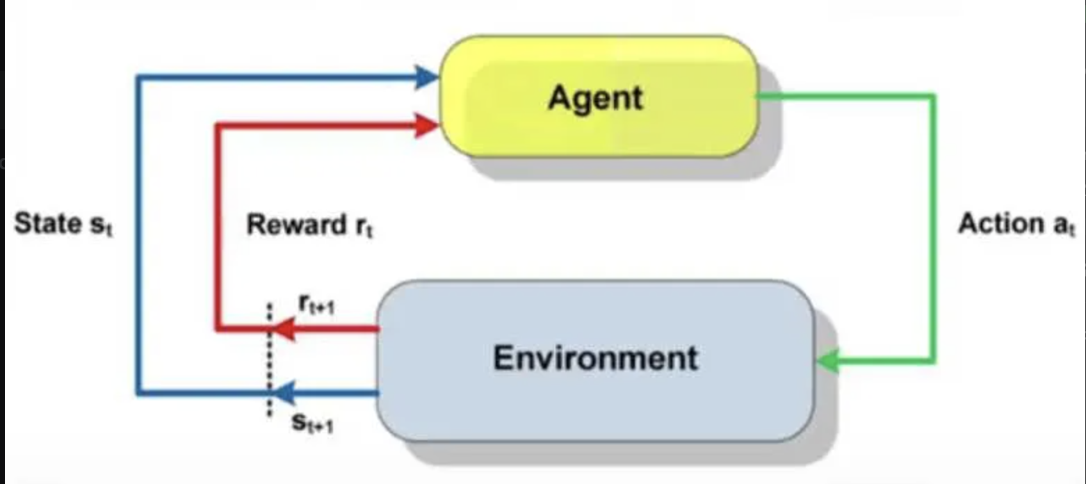
Reinforcement Learning
Agent and Environment
-Reinforcement Learning (RL): A type of machine learning where an agent learns to make decisions by interacting with an environment to maximise cumulative reward.
-Agent: The learner or decision-maker.
-Environment: The system with which the agent interacts.
-Reward: Feedback from the environment based on the agent’s actions.

Slide 3
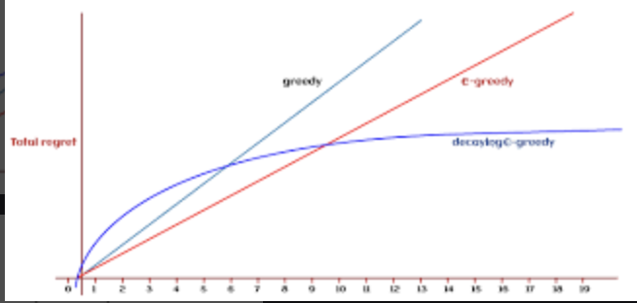
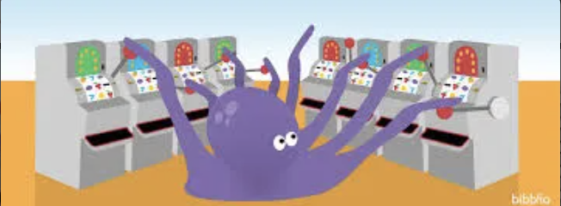
Exploration vs Exploitation
Epsilon Strategy ϵ
Exploration: Trying new actions to discover their rewards.
Exploitation: Choosing the best-known action based on past experience.
Epsilon is a parameter that decides if the agent explores new options or sticks to the best known option .

Slide 4
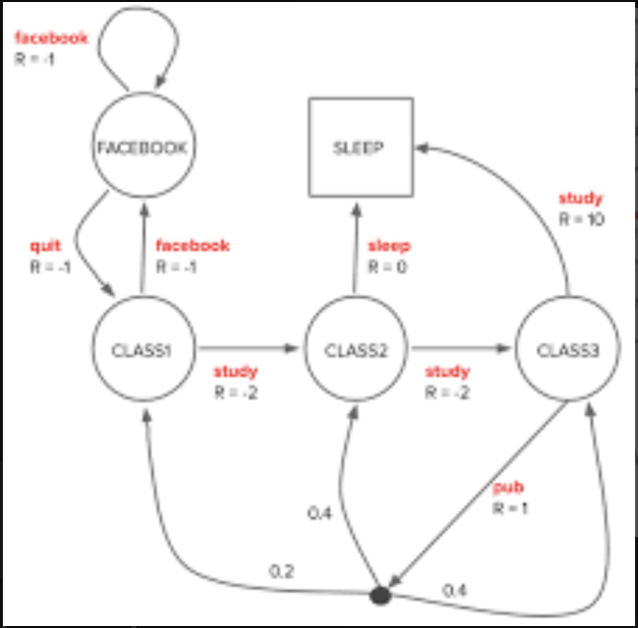
Markov Decision Process (MDP)
Understanding K-Armed Bandits
Markov Property :
“The future is independent of the past given the present”
K Arm Bandit Problem using epsilon greedy strategy .

Slide 5
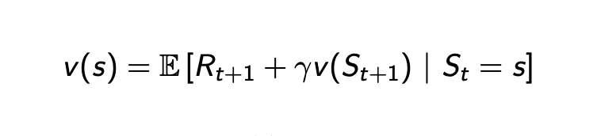
Bellman Equation
The Foundation of Dynamic Programming
This equation expresses the relationship between the value of a state and the values of its successor states.

Slide 6
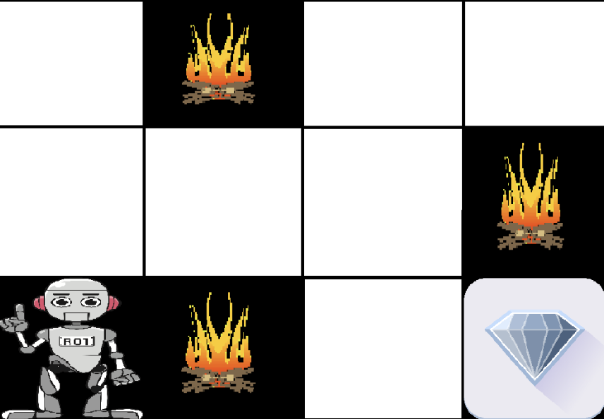
Dynamic Programming
Value Function and Policy Iteration
Value Function (V): Measures the expected cumulative reward from each state.
Policy (π): A strategy that specifies the action to take in each state.
GridWorld : Classic control problem in RL in which a agent solves a grid by itself using value and policy iteration.

Slide 7

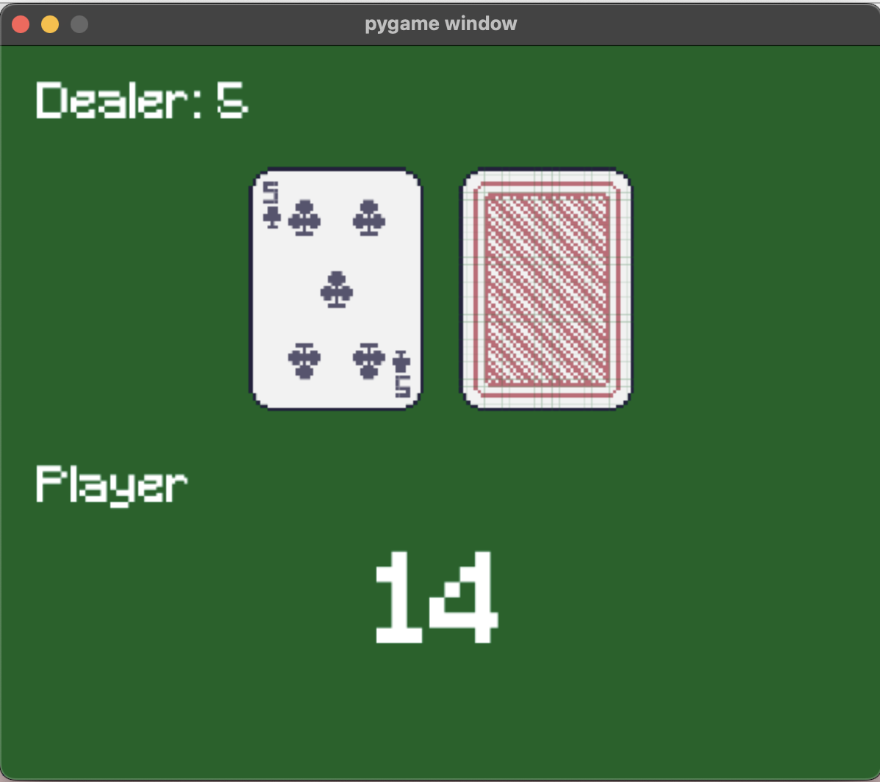
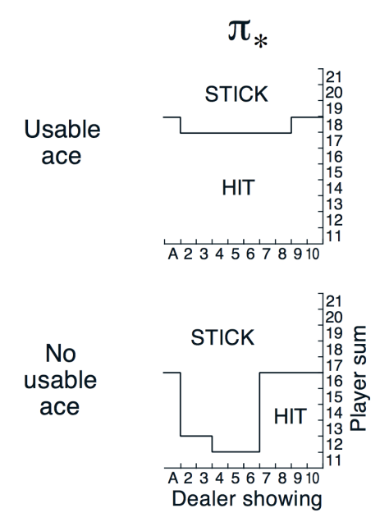
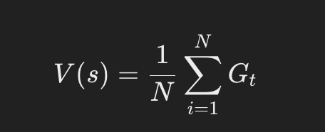
Monte Carlo Algorithm
Application to Blackjack
The term "Monte Carlo" refers to the use of random samples from the environment to estimate the expected return or value of a state-action pair.
BLACK-JACK

Slide 8
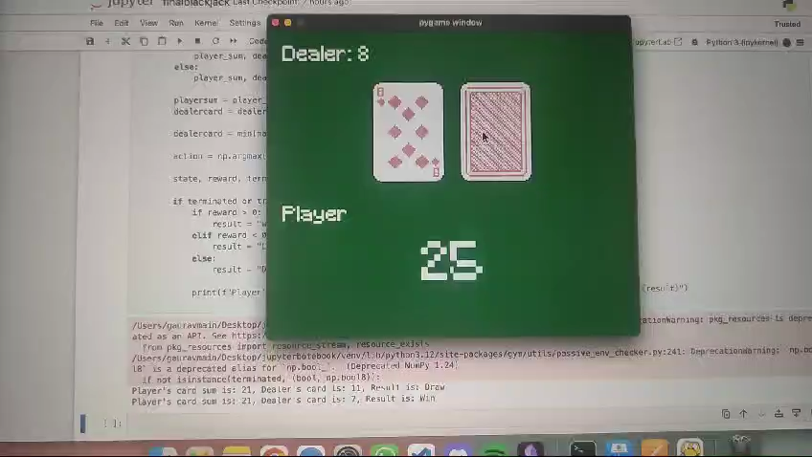
BLACK JACK:
BLACK JACK IS A TOY TEXT ENVIRONMENT IN OPEN AI GYM IN WHICH THE GAME OF BLACK JACK IS SIMULATED .

Slide 9
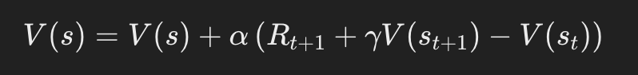
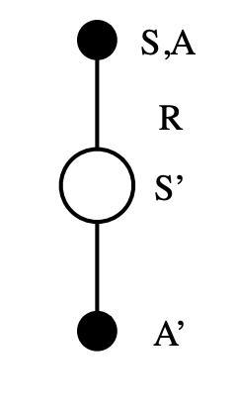
Temporal Difference (TD) Learning
TD(λ) - A Unification of Monte Carlo and Dynamic Programming
TD(λ):
Combines TD and Monte Carlo, where λ controls the trade-off between them.

Slide 10
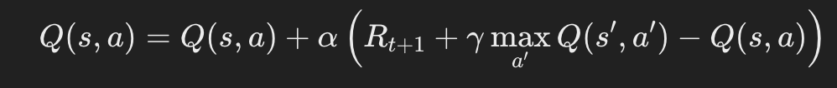
Q-Learning
A model-free algorithm that learns the value of action-state pairs.
Most used RL algorithm
Problems solved with q learning :
Mountain Car
Cartpole
Frozen Lake

Slide 11
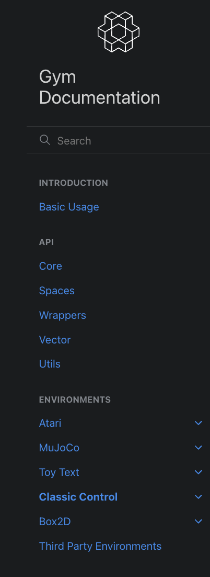
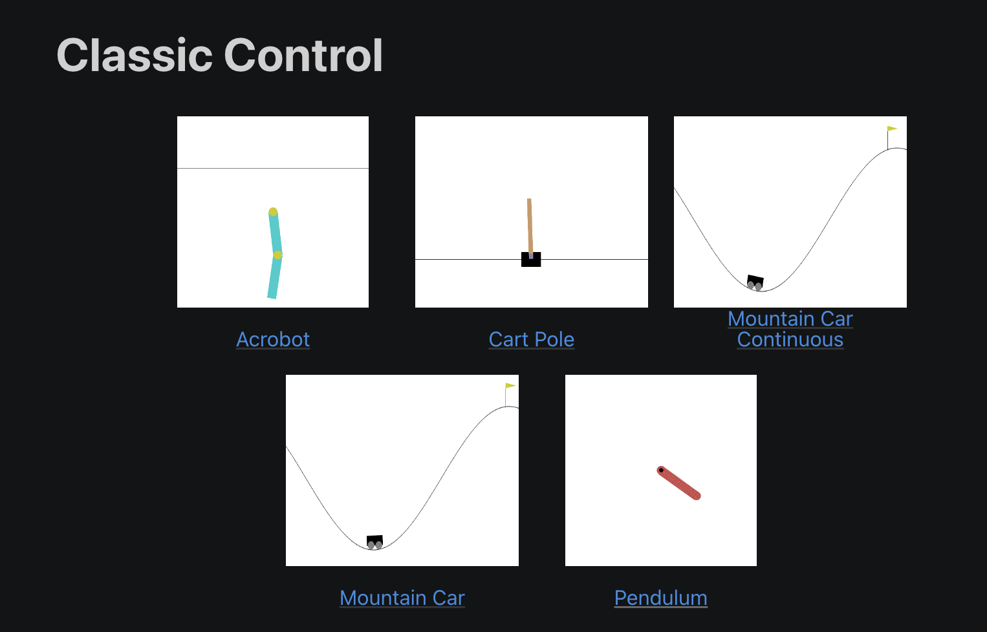
Introduction to OpenAI Gym
A Toolkit for Developing RL Algorithms
OpenAI Gym:
A platform providing a wide variety of environments for testing and developing RL algorithms.
WHAT WE HAVE IMPLEMENTED IN CLASSIC CONTROL:
MOUNTAIN CAR
CARTPOLE

Slide 12
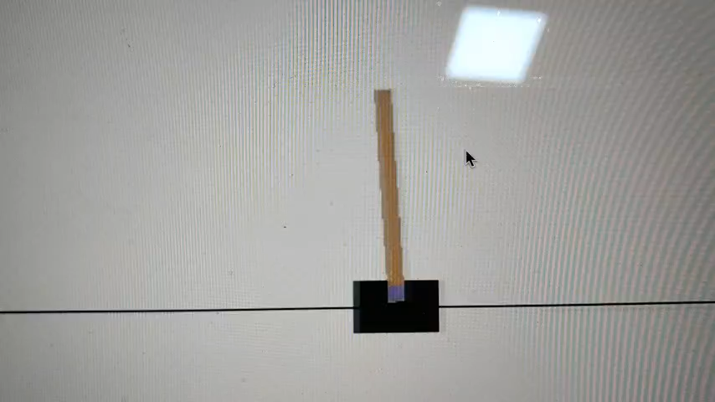
IMPLEMENTATIONS DONE USING Q-LEARNING :
THSES ARE SOME OF THE IMPLEMENTATIONS DONE USING OPEN AI GYM
CARTPOLE : THE AIM OF THE CONTROL PROBLEM IS TO BALANCE THE POLE BY MOVIING THE CART LEFT OR RIGHT .

Slide 13
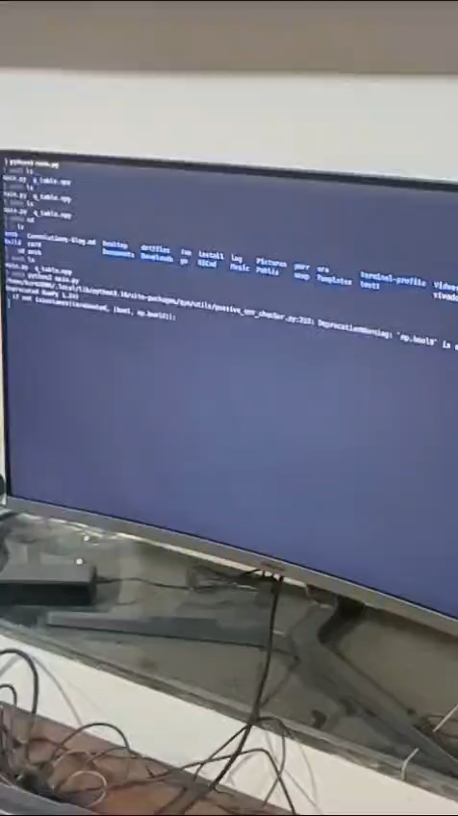
MOUNTAIN CAR :
THE OBJECTIVE OF THIS CONTROL IS TO MAKE THE CAR REACH THE TOP OF THE MOUNTAIN

Slide 14
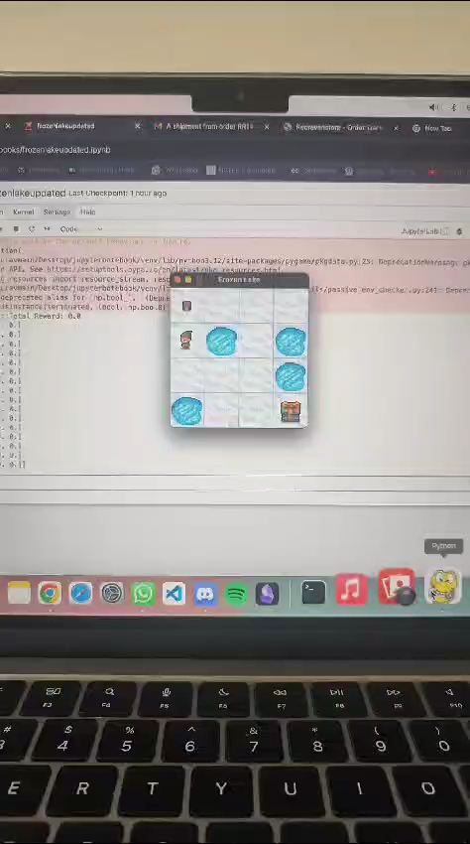
FROZEN LAKE :
THE OBJECTIVE OF THIS TOY TEXT ENVIRONMENT IS TO REACH THE PRIZE BOX .

Slide 15
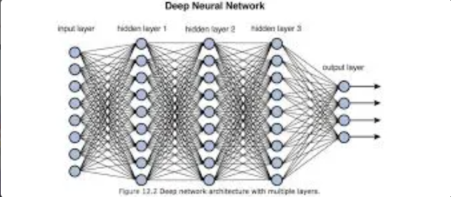
Deep Q-Learning and Neural Networks
Role of NNs and CNNs in RL
Deep Q-Learning: Extends Q-Learning by using neural networks to approximate Q-values.
CNNs: Convolutional Neural Networks process visual data, allowing agents to learn directly from pixels (e.g., in Atari games).

Slide 16
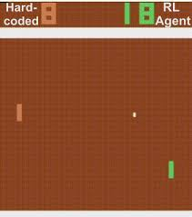
RL in Atari Games
Pong
Atari Games: RL has been successfully applied to play and master a wide range of Atari games.
We have implemented Rl on Pong using Neural networks and convolutional Neural Networks .
Objective of the game is to not let the ball
cross our control paddle

Slide 17
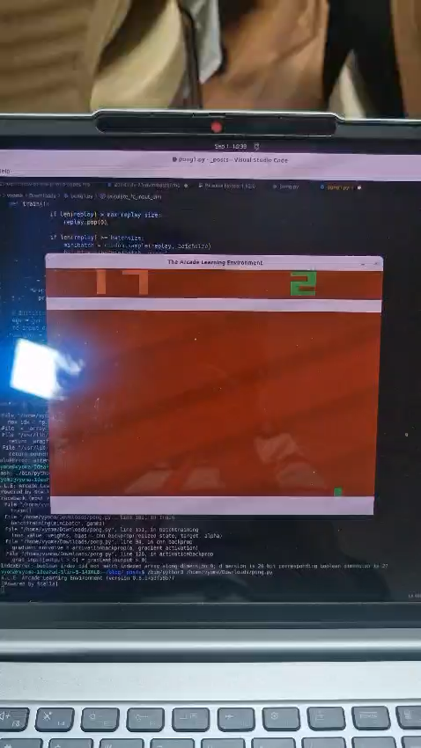

Slide 18
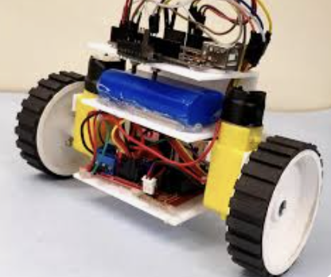
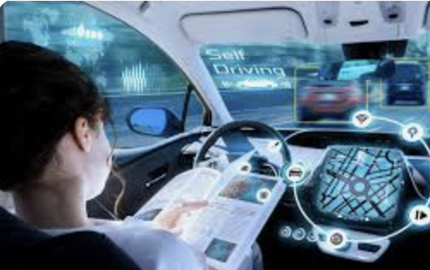
Problems faced:
Gym version not compatible with pcs
Dependency errors arise while trying to execute the pong game
Future Goals :
Implementing pong using libraries such as keras and TensorFlow for better and efficient results
Implementation of RL on a self-balancing bot

Slide 19
THANK YOU

